Slide 1
Presentation 11
Instructions for Using SEAWAT Version 4
Notes:
SEAWAT Training Course
Lecture 11

Slide 2
Using SEAWAT Version 4
Obtaining the program and current information
Name (NAM) file
Preparation of the VDF (and VSC) input file
Considerations for MODFLOW packages
Preparation of MT3DMS datasets
Running SEAWAT_V4

Slide 3
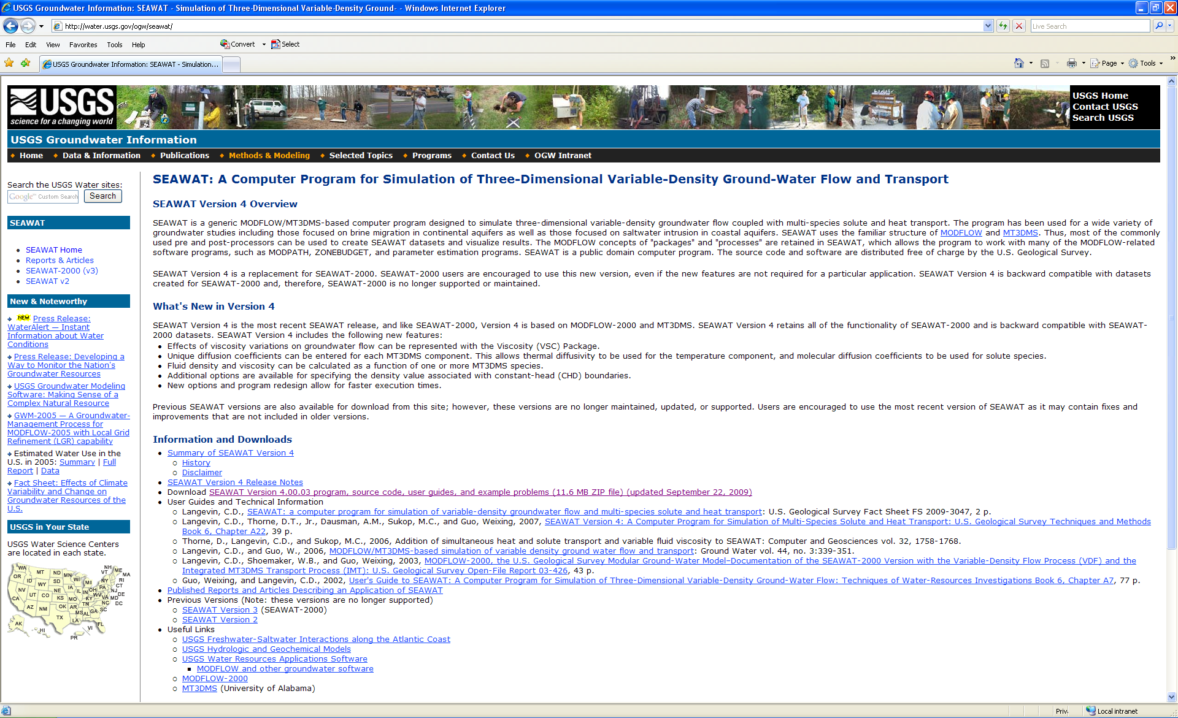
SEAWAT Website

Slide 4
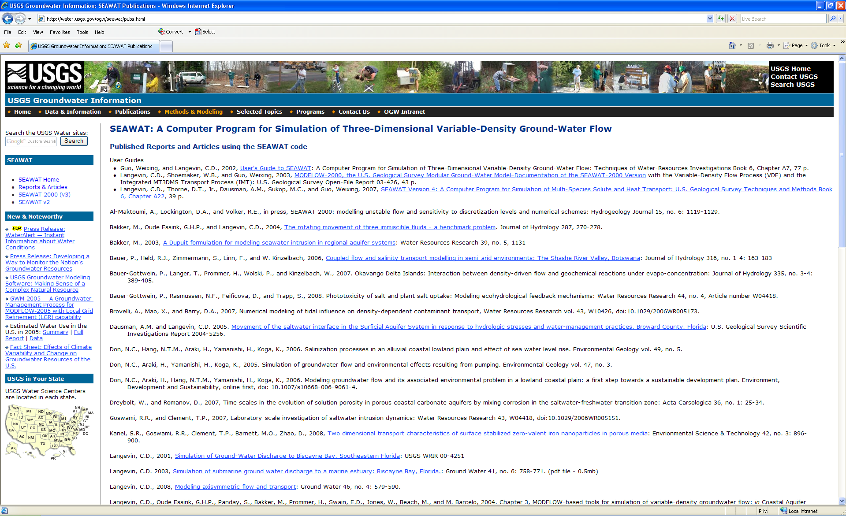
Online list of SEAWAT references

Slide 5
Name File
Name file is requested when SEAWAT Version 4 runs
Contains filetype, unit number, filename
Contains file information for:
  MODFLOW-2000 files
  MT3DMS files
  Variable-Density Flow (VDF) input file
  Viscosity Package (VSC) input file [optional]
Vistas creates valid SEAWAT Version 4 name file

Slide 6
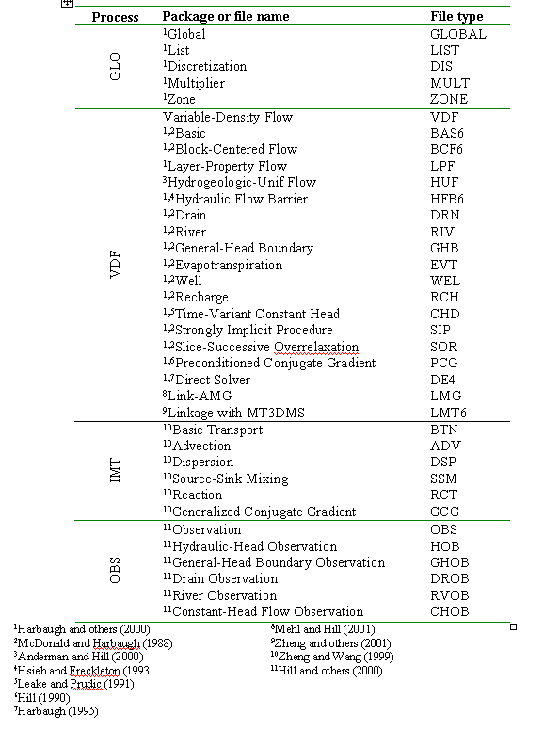
List of Packages and Input Files
Also includes:
HUF2
FHB
ETS
DRT
MNW
TOB

Slide 7
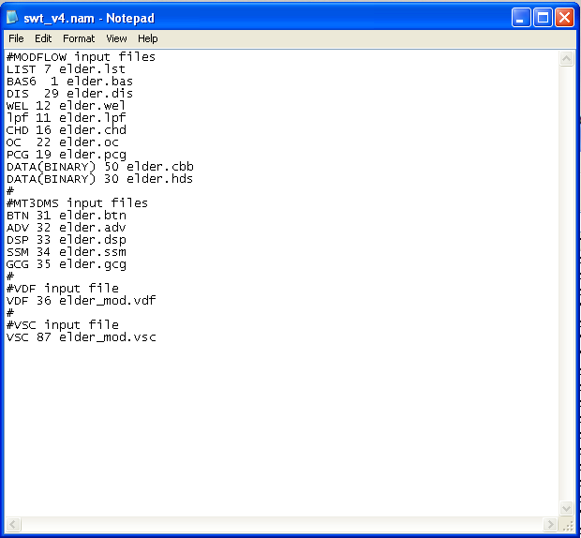
Example Name File

Slide 8
Discretization File (DIS)
Required file
For variable-density flow simulations, need to include enough vertical resolution
Caution about using quasi-3D confining units
  Should only use if there is no solute transfer across unit
  Not implemented yet in SEAWAT Version 4

Slide 9
VDF Input File
By including in name file will activate the VDF process (otherwise GWF)
Can have variable-density flow affected by one or more species
VDF file is created by Groundwater Vistas

Slide 10
VDF File (cont.)
FOR EACH SIMULATION
0. [#Text]
Item 0 is optional and the symbol # must be in column 1. Item 0 can be repeated multiple times, but it cannot be used in the file after the first data record.
1. MT3DRHOFLG MFNADVFD NSWTCPL IWTABLE
2. DENSEMIN DENSEMAX
Read Item 3 if NSWTCPL > 1 or NSWTCPL = -1
3. DNSCRIT
Read Item 4 if MT3DRHOFLG ≥ 0
4. DENSEREF DRHODC(1)
Read Item 4a through 4c if MT3DRHOFLG = -1
4a. DENSEREF DRHODPRHD PRHDREF
4b. NSRHOEOS
4c. MTRHOSPEC(NSRHOEOS) DRHODC(NSRHOEOS) CRHOREF(NSRHOEOS)
Item 4c is read as a table, with one row representing each MT3DMS species to be included in the equation of state for fluid density. There is no requirement that this table be sorted by MTRHOSPEC.
5. FIRSTDT
FOR EACH STRESS PERIOD
Read Items 6 and 7 only if MT3DRHOFLG = 0
6. INDENSE
Read Item 7 only if INDENSE is greater than zero
7. [DENSE(NCOL,NROW)] – U2DREL
Item 7 is read for each layer in the grid.

Slide 11
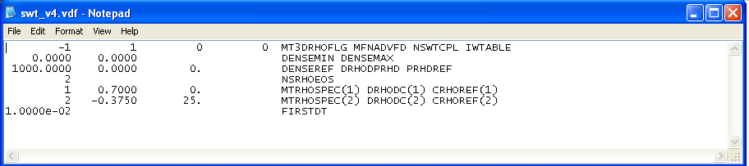
VDF File (cont.)
Example VDF file
or
-1 1 -1 0 MT3DRHOFLG MFNADVFD NSWTCPL IWTABLE
0.0000 0.0000 DENSEMIN DENSEMAX
0.0000 DNSCRIT
1000.0000 4.46E-03 0. DENSEREF DRHODPRHD PRHDREF
2 NSRHOEOS
1 0.7000 0. MTRHOSPEC(1) DRHODC(1) CRHOREF(1)
2 -0.3750 25. MTRHOSPEC(2) DRHODC(2) CRHOREF(2)
1.0000e-02 FIRSTDT

Slide 12
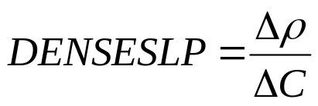
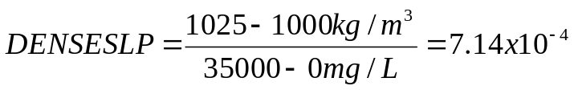
DENSEREF and DENSESLP
Concentration
units | freshwater | seawater
mg/L | 0 | 35,000
g/L | 0 | 35
lbs/ft³ | 0 | 2.188
relative | 0 | 1
Density
units | Freshwater (DENSEREF) | seawater
g/cm³ | 1 | 1.025
kg/m³ | 1000 | 1025
lbs/ft³ | 62.42 | 63.98
Example:
use concentration in mg/L and density in kg/m³
Density length units must be same as length units used for model grid, hydraulic conductivity, etc.

Slide 13
VSC Input File
By including in name file will activate the VSC option
VSC file is created by Groundwater Vistas
Have multiple options from manual
  Concentration
  Temperature

Slide 14
VSC File
FOR EACH SIMULATION
0. [#Text]
Item 0 is optional and the symbol # must be in column 1. Item 0 can be repeated multiple times.
1. MT3DMUFLG
2. VISCMIN VISCMAX
Read item 3 if MT3DMUFLG ≥ 0
3. VISCREF DMUDC(1) CMUREF(1)
Read item 3a through 3c if MT3DMUFLG = -1
3a. VISCREF
3b. NSMUEOS MUTEMPOPT
3c. MTMUSPEC(NSMUEOS) DMUDC(NSMUEOS) CMUREF(NSMUEOS)
Item 3c is read NSMUEOS times, once for each MT3DMS species to be included in the viscosity equation.
3d. MTMUTEMPSPEC AMUCOEFF(MUNCOEFF)
Item 3d is read if MUTEMPOPT > 0. The size of the AMUCOEFF coefficient array depends on the selected equation for viscosity.
FOR EACH STRESS PERIOD
Read items 4 and 5 only if MT3DMUFLG = 0
4. INVISC
Read item 5 only if INVISC is greater than zero
5. [VISC(NCOL,NROW)] – U2DREL
Item 5 is read for each layer in the grid.

Slide 15
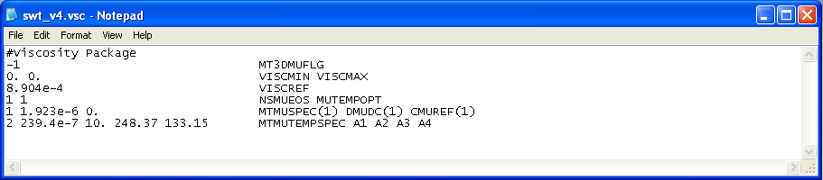
VSC File (cont.)
Example VSC file

Slide 16
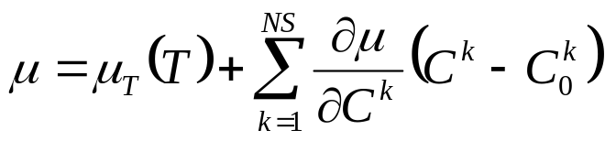
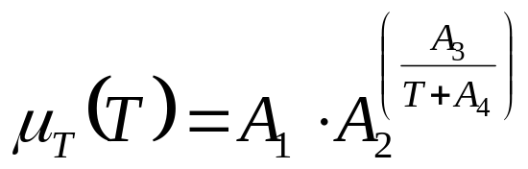
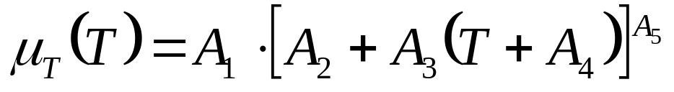
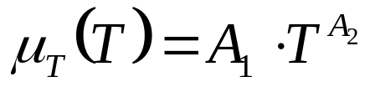
VSC File (cont.)
Viscosity as a function of temperature: 3 options

Slide 17
Special Considerations for Packages
All input and output is expressed in terms of head (not equivalent freshwater head)
All storage and hydraulic properties must be represented in terms of equivalent freshwater values (or relative to the reference density)

Slide 18
Use of Auxiliary Variables for Flow Packages
Source-term package
Auxiliary variable name
Description
Default value (if not entered using auxiliary variable)
Well
WELDENS
Density of injection well fluid
DENSEREF
Drain
DRNBELEV
Drain bottom elevation
Cell center
River
RBDTHK
Thickness of riverbed sediments
Difference between river bottom elevation and cell center
River
RIVDEN
Density of river
Density of model cell
General-Head Boundary
GHBELEV
Elevation of the general-head boundary
Cell center
General-Head Boundary
GHBDENS
Density of general-head boundary fluid
Density of model cell

Slide 19
Solver Packages
Variable-density simulations may require a smaller value for head convergence in order to calculate accurate vertical flow velocities
Residual criterion for flow convergence (RCLOSE, in PCG) may be set larger than for a similar constant-density flow problem by a factor of the density

Slide 20
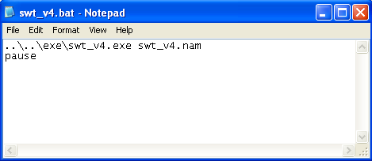
Running SEAWAT Version 4
On a PC:
Double-click on swt_v4.bat in file manager

Slide 21
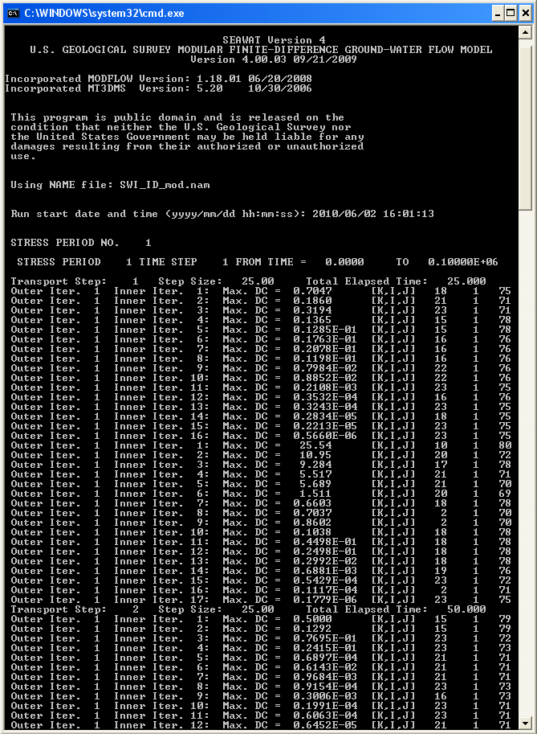
Screen Output

Slide 22
Model Results of Interest
Screen Output
Listing Files
  Flow budget
  Solute mass budget
Heads
Flows
Concentrations
  Unformatted concentration file
  Concentration observations
Solute mass budget

Slide 23
Post Processing
Groundwater Vistas
Modelviewer
Zone Budget
MT3DMS
MODPATH
ETC…

Slide 24
Simultaneous Solute and Heat Transport Simulations
Density and viscosity variations may be important
Some MT3DMS input parameters must be entered as solute equivalents

Slide 25
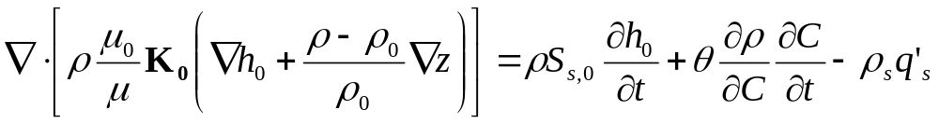
Flow Equation
What’s different when including temperature effects?
Prefer “reference” instead of “equivalent freshwater”
density is a function of concentration and temperature
viscosity variations may be more important

Slide 26
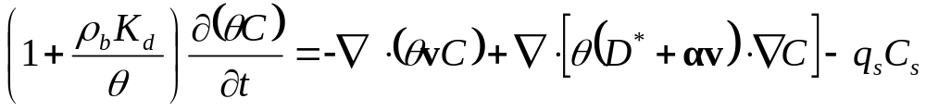
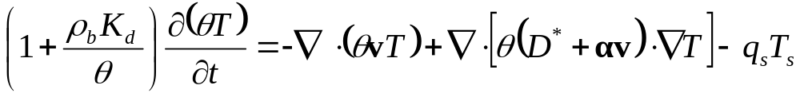
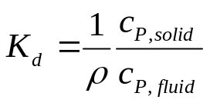
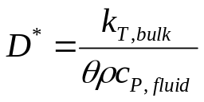
Transport Equations
mechanical
dispersion
sorption
advection
diffusion
source/sink
mechanical
dispersion
heat storage
convection
conduction
source/sink

Slide 27
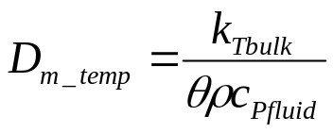

DSP Input File
$MultiDiffusion
0 1.000(10E12.4) -1 DISPERSIVITY Layer 1
0 1.000(10E12.4) -1 DISPERSIVITY Layer 2
(layers 3 through 99 not shown)
0 1.000(10E12.4) -1 DISPERSIVITY Layer 100
0 0.100(10E12.4) -1 HZ DISPERSIVITY RATIO
0 0.100(10E12.4) -1 VT DISPERSIVITY RATIO
0 1.0E-10 -1 MOL DIFF SP 1 LAYER 001
0 1.0E-10 -1 MOL DIFF SP 1 LAYER 002
(layers 3 through 99 not shown)
0 1.0E-10 -1 MOL DIFF SP 1 LAYER 100
0 0.15 -1 MOL DIFF SP 2 LAYER 001
0 0.15 -1 MOL DIFF SP 2 LAYER 002
(layers 3 through 99 not shown)
0 0.15 -1 MOL DIFF SP 2 LAYER 100

Slide 28
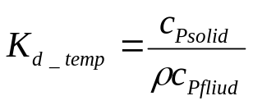
RCT Input File
1 0 2 0
0 1760.000(10E12.4) -1 Blk Dnsty Lay 1
0 1760.000(10E12.4) -1 Blk Dnsty Lay 2
(layers 3 through 99 not shown)
0 1760.000(10E12.4) -1 Blk Dnsty Lay 100
00.0000e+00(10E12.4) -1 Kd Species 1 Lay 1
00.0000e+00(10E12.4) -1 Kd Species 1 Lay 2
(layers 3 through 99 not shown)
00.0000e+00(10E12.4) -1 Kd Species 1 Lay 100
02.0000e-04(10E12.4) -1 Kd Species 2 Lay 1
02.0000e-04(10E12.4) -1 Kd Species 2 Lay 2
(layers 3 through 99 not shown)
02.0000e-04(10E12.4) -1 Kd Species 2 Lay 100
00.0000e+00(10E12.4) -1 SP2 Sp 1 not used Lay 1
00.0000e+00(10E12.4) -1 SP2 Sp 1 not used Lay 2
(layers 3 through 99 not shown)
00.0000e+00(10E12.4) -1 SP2 Sp 1 not used Lay 100
00.0000e+00(10E12.4) -1 SP2 Sp 2 not used Lay 1
00.0000e+00(10E12.4) -1 SP2 Sp 2 not used Lay 2
(layers 3 through 99 not shown)
00.0000e+00(10E12.4) -1 SP2 Sp 2 not used Lay 100

Slide 29
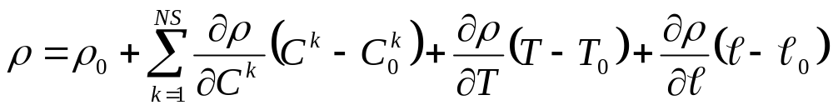
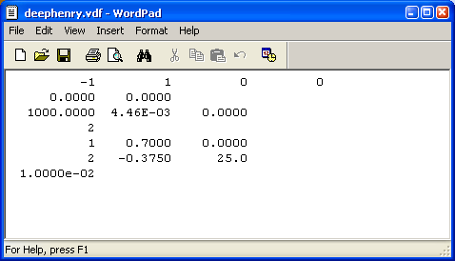
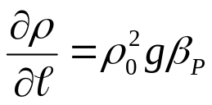
Density Equation of State
Multiple-species
Temperature
Water Compressibility

Slide 30
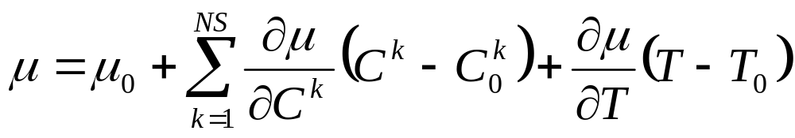
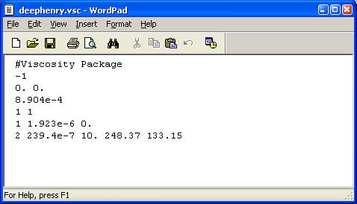
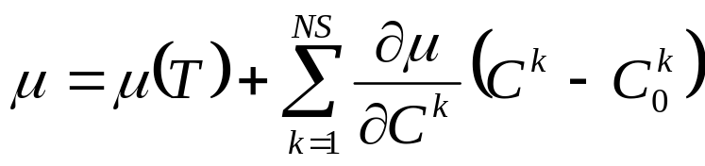




Constitutive Relation for Viscosity
or
MUTEMPOPT
1
2
3
e.g. SUTRA

Slide 31
Things to Consider
Density is a function of C and T
  Include relations in VDF Input file
Viscosity Variations?
  VSC Package must be used with LPF—does not work with BCF or HUF
Heat Transport Processes
  Conduction—need to calculate effective “diffusion coefficient” and include in DSP package
  Heat storage in solid—need to calculate effective “distribution coefficient” and include in RCT package
  Heat flux—calculate effective “mass flux” and include in SSM package (ITYPE=15)

